Slide 1
Framework for Multidisciplinary Optimization
M Vishnu Sankar (18B030013)
Prof. Abhijit Gogulapati

Slide 2

Contents
Why MDO?
Motivation, Goal and Deliverables
Framework Development
Framework Building-II
Framework Building-I
Challenges in FB-I
Framework Testing and Results
Conclusion & Future Work

Slide 3
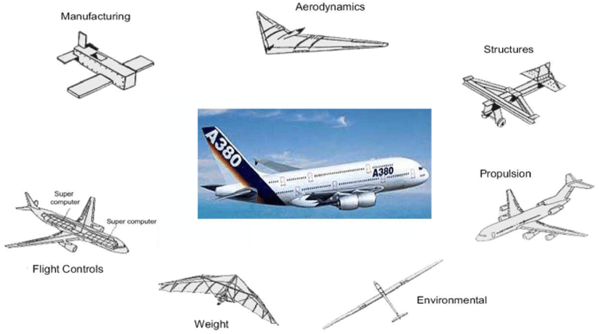
Why Optimization?
Notes:
Deliverables
A robust framework that's versatile to integrate any number of disciplines
Communicate seamlessly with different analysis tools
Predicts an optima or a set of optima which are better than baseline design
Problem Definition
Theoretical structure for the seamless interfacing of different solvers/analysis tools
Test it by actual implementation

Slide 4
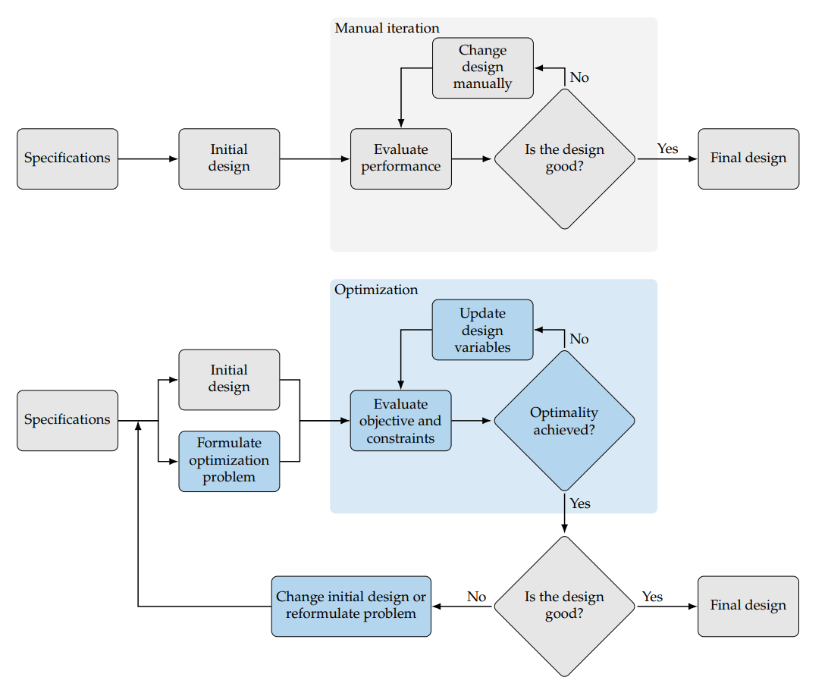
Traditional Approach
But why automation? Why is a framework necessary?
Notes:
Deliverables
A robust framework that's versatile to integrate any number of disciplines
Communicate seamlessly with different analysis tools
Predicts an optima or a set of optima which are better than baseline design
Problem Definition
Theoretical structure for the seamless interfacing of different solvers/analysis tools
Test it by actual implementation

Slide 5
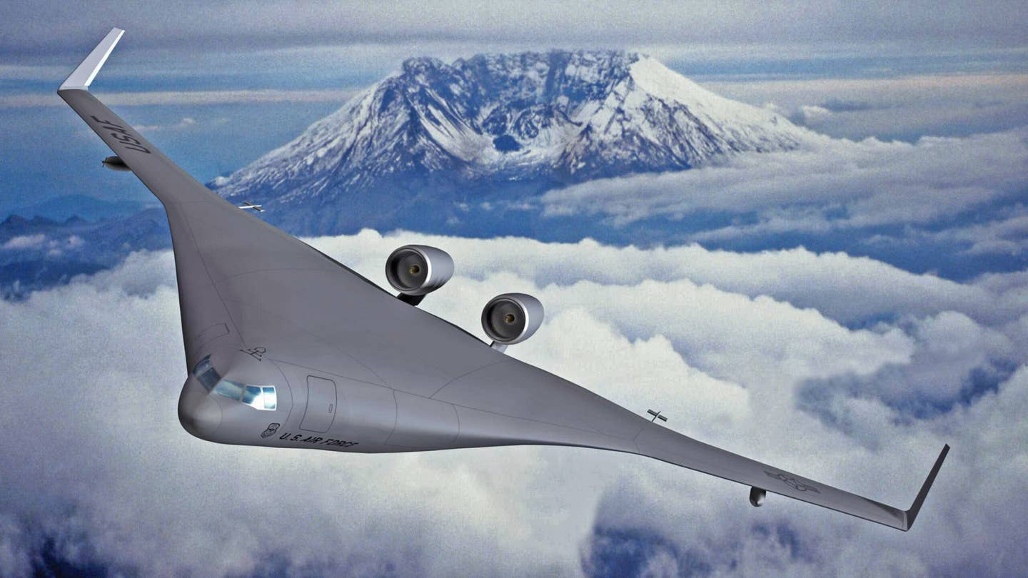
New Requirements – New Approach
"The Department of Defense (DoD) is seeking a concept of design (CoD) of an advanced aircraft configuration that provides at least 30% more aerodynamic efficiency than the Boeing 767 and Airbus A330 families of commercial and military aircraft, enabling operational advantages such as increased range, loiter time, and offload capabilities. When integrated with projected 2030 engine technology, this advanced aircraft configuration is expected to provide at least 60 percent mission fuel burn reduction compared to current day technology"
Notes:
Deliverables
A robust framework that's versatile to integrate any number of disciplines
Communicate seamlessly with different analysis tools
Predicts an optima or a set of optima which are better than baseline design
Problem Definition
Theoretical structure for the seamless interfacing of different solvers/analysis tools
Test it by actual implementation

Slide 6

Tightly Coupled Integrated Systems
AeroD
Structures
Propulsion
Controls
Notes:
Deliverables
A robust framework that's versatile to integrate any number of disciplines
Communicate seamlessly with different analysis tools
Predicts an optima or a set of optima which are better than baseline design
Problem Definition
Theoretical structure for the seamless interfacing of different solvers/analysis tools
Test it by actual implementation

Slide 7
Relevance of a Framework
Notes:
Deliverables
A robust framework that's versatile to integrate any number of disciplines
Communicate seamlessly with different analysis tools
Predicts an optima or a set of optima which are better than baseline design
Problem Definition
Theoretical structure for the seamless interfacing of different solvers/analysis tools
Test it by actual implementation

Slide 8
Features of the Framework
Solver Agnostic
Simple plug and run with any solver
Treat analysis tools as black boxes
Modularity
Integrate additional disciplines without modification
Building on top of each other
Simplicity
User need not work with more than 2 files at most
Scalability & Flexibility
Scaling to thousands of design variables should be feasible
Efficient Gradient Evaluation
Offer different methods to compute gradients efficiently
Goals of this Project
Leverage OpenMDAO* [1]
Notes:
Solver Agnostic
Simple plug and run capability for any analysis tools with very minimal changes to the framework
Treats analysis tools as a black box
Modularity
Integrate additional disciplines without modifying other discipline structure
Building on top of each other
Simplicity
User need not work with more than at most 2 files
Scalability & Flexibility
Scaling to thousands of design variables should be feasible
Efficient Gradient Evaluation
Offer different methods to compute gradients efficiently

Slide 9

Design of the Framework

Slide 10
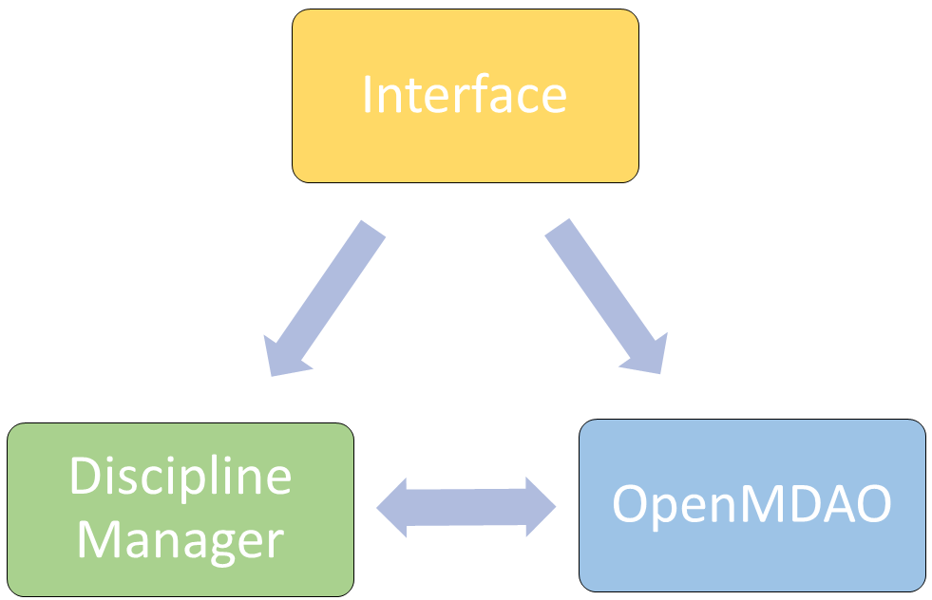
Three Key Modules of the Framework
Note:
Arrows do not indicate flow of information or order of processes carried out
Notes:
For four key tasks are identified
1. Optimization
2. User interface
3. Outflow Processor – Responsible for processing and managing all the analysis
4. Inflow Processor – Responsible for evaluating and fetching all the design variables, obj functions, constraints

Slide 11
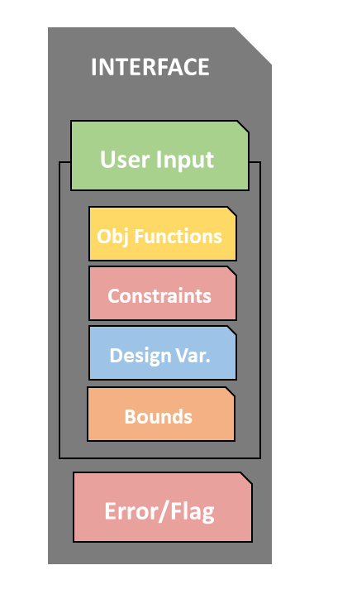
Interface
User inputs to define the setup
Only 1 or 2 files at max. to tweak
Structure is similar to Optimization packages in Python/MATLAB
Check for consistency and errors
Notes:
Module Manager: Receives the input as vectors, the design variables are classified on the basis of their disciplines and sent to the discipline module. Module manager is the primary tool that inputs as well as outputs the necessary information from OpenMDAO to the discipline manager.

Slide 12
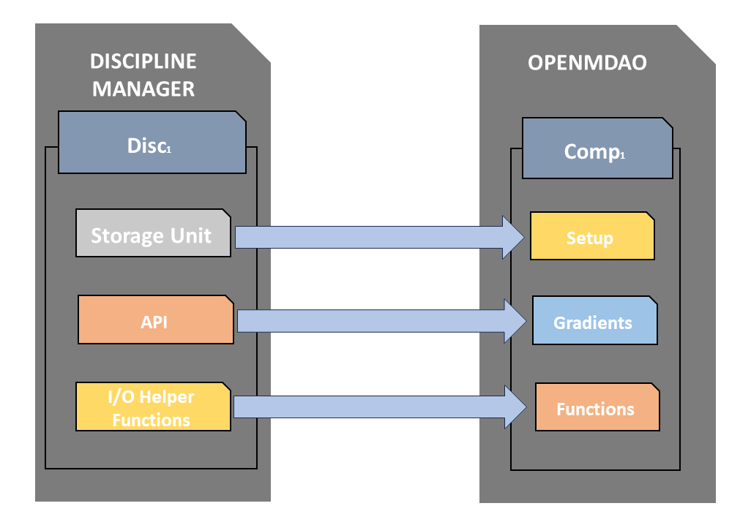
OpenMDAO + Discipline Manager
Notes:
Module Manager: Receives the input as vectors, the design variables are classified on the basis of their disciplines and sent to the discipline module. Module manager is the primary tool that inputs as well as outputs the necessary information from OpenMDAO to the discipline manager.

Slide 13

Framework Building - I

Slide 14
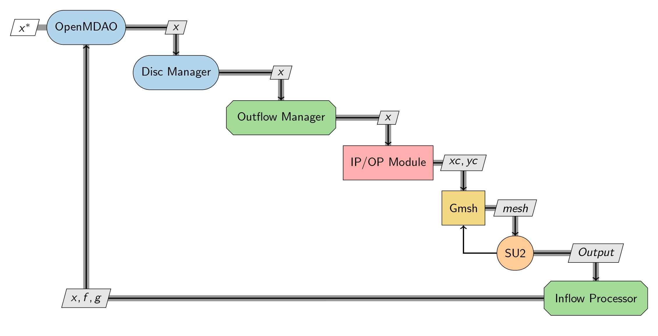
Framework for 2D ASO
Some of the methods used here are directly inspired from Sachit Vekaria’s work on “Multi-disciplinary Design Optimization for Aerodynamic Efficiency and RCSR” under the guidance of Professor Avijit Chatterjee, Professor Bharat Adsul and Professor Hemandra Arya.

Slide 15
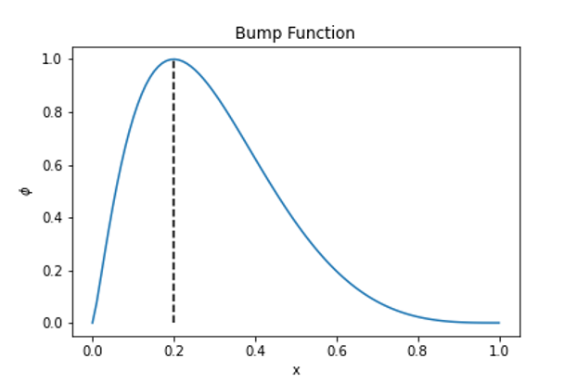
Common Parameters
Parameters | Methods/Values
Optimization Algorithms | SLSQP
Tolerance | 10E-6
Gradients | Finite Differencing
Mesh Strategy | Remesh the entire domain
Geometry Parameterization | Bump Function

Slide 16
Benchmarking with SU2 Test Case
Problem Setup
Obj Fn | Min. Cd
DV | 20 shape amplitudes
Constraints | None
Parameters | Values
Mach no. | 0.8
AoA | 1.25deg
Flow | Inviscid
Solver | Euler

Slide 17
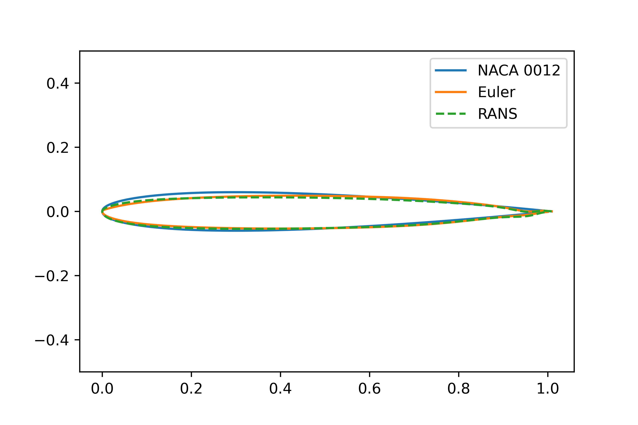
Benchmarking with SU2 Test Case
Results​
Baseline Cd​ | 209.95​
Optimized Euler​ | 4.39​
Optimized Test Case​ | 4.5​
Optimized RANS​ | 27.47​

Slide 18
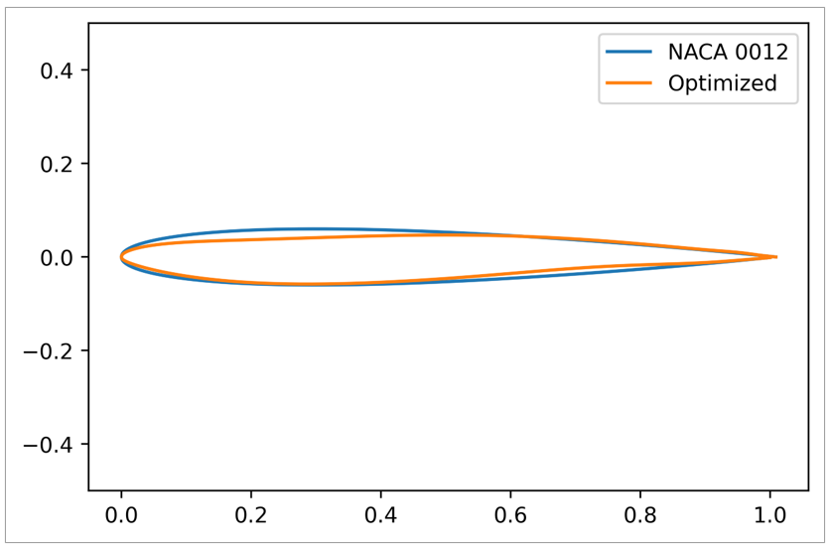
Results – 2D | Constrained Optimization
Constrained Problem
M = 0.8
AOA = 1.25 degrees
Problem Setup
Obj Fn | Min. Cd
DV | 20 shape amplitudes
Constraints | Cl*>0.4 A*/A > 0.85
Function | OpenMDAO Optimized
Cd | 0.0025126 (88%)
Cl | 0.4

Slide 19
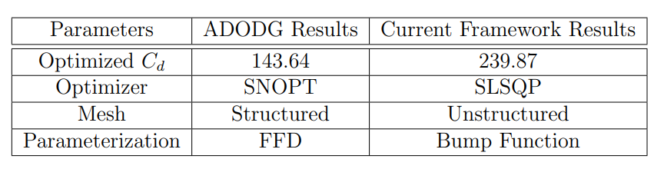
Benchmarking with ADODG Test Case-1
Problem Setup
Obj Fn | Min. Cd
DV | 20 shape amplitudes
Constraints | Thickness > Baseline's
Parameters | Values
Mach no. | 0.85
AoA | 0 deg
Flow | Inviscid
Solver | Euler

Slide 20
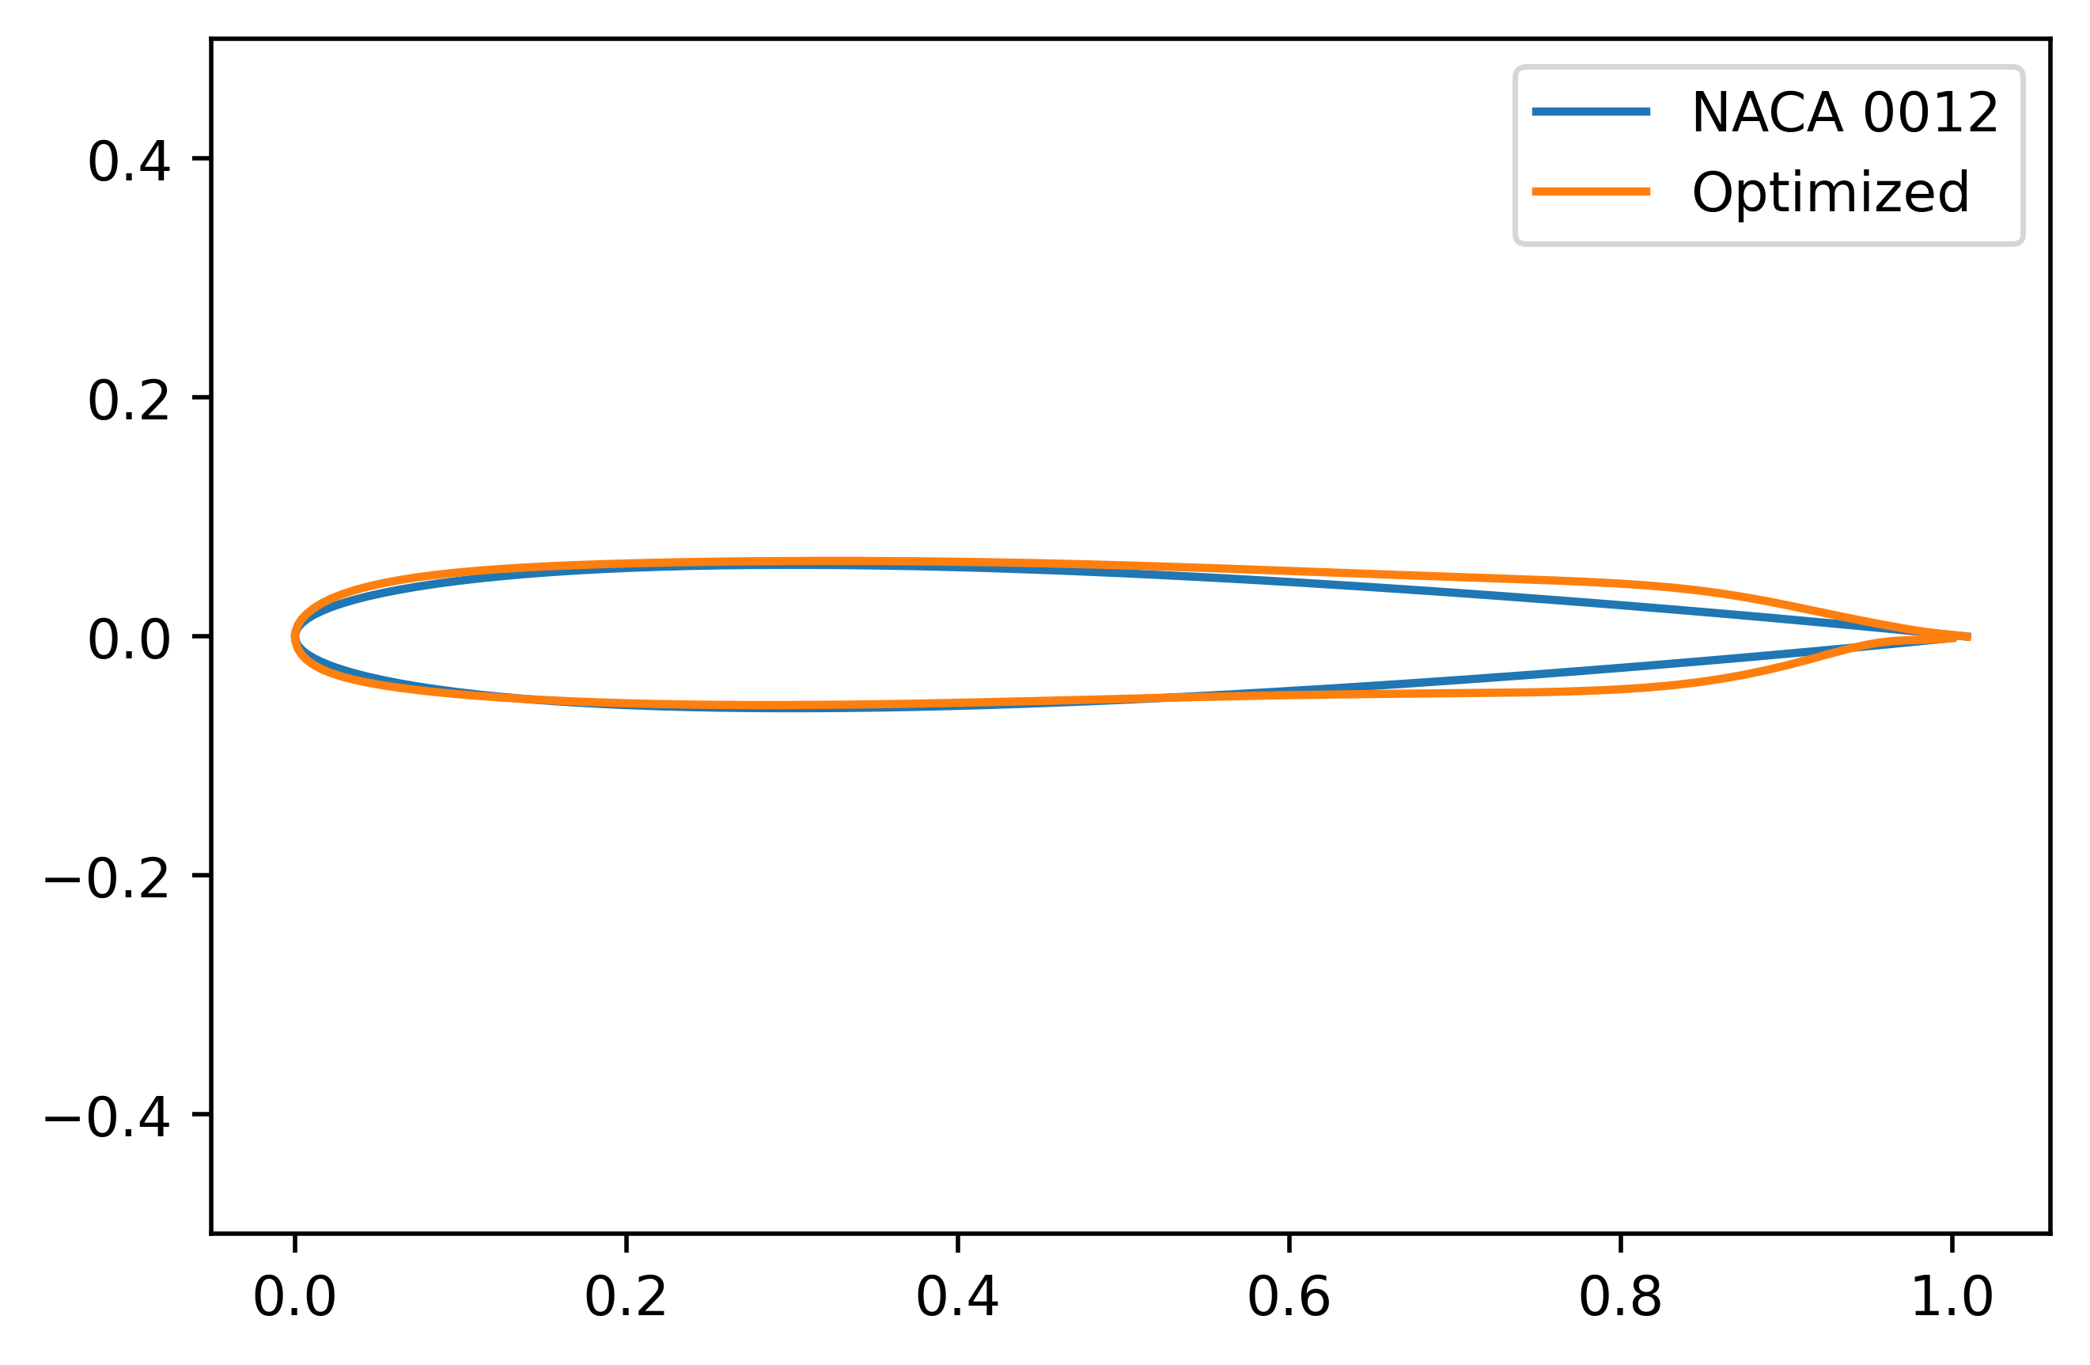
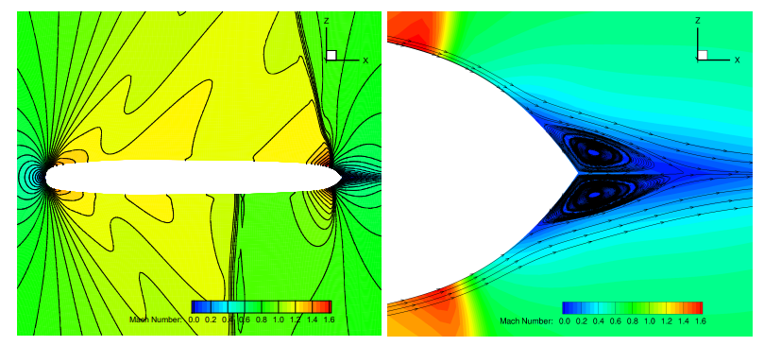
Benchmarking with ADODG Test Case-1

Slide 21
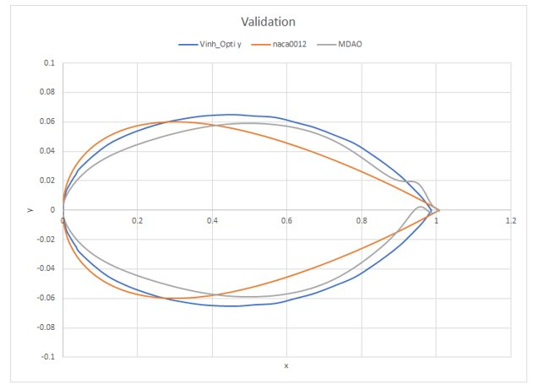
RCS + CFD
Obj Fn | Min. Cd
DV | 20 shape amplitudes
Constraints | A*/A >1 RCS*/RCS < 0.7
Cd baseline | 92
Cd optimized | 84
Cd optimized Vinh | 71
Parameters | Values
Mach no. | 0.8
AoA | 1.25deg
Flow | Inviscid
CFD Solver | Euler
CEM Solver | MLFMM*
*Multi-Level Fast Multipole Method

Slide 22
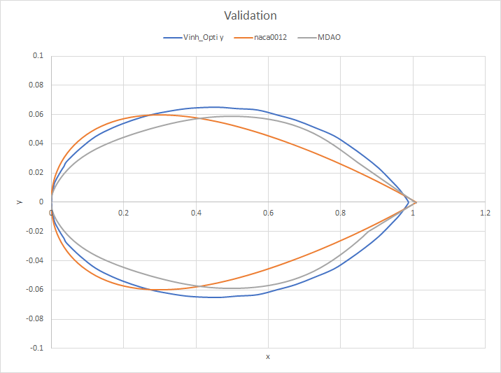
RCS + CFD

Slide 23
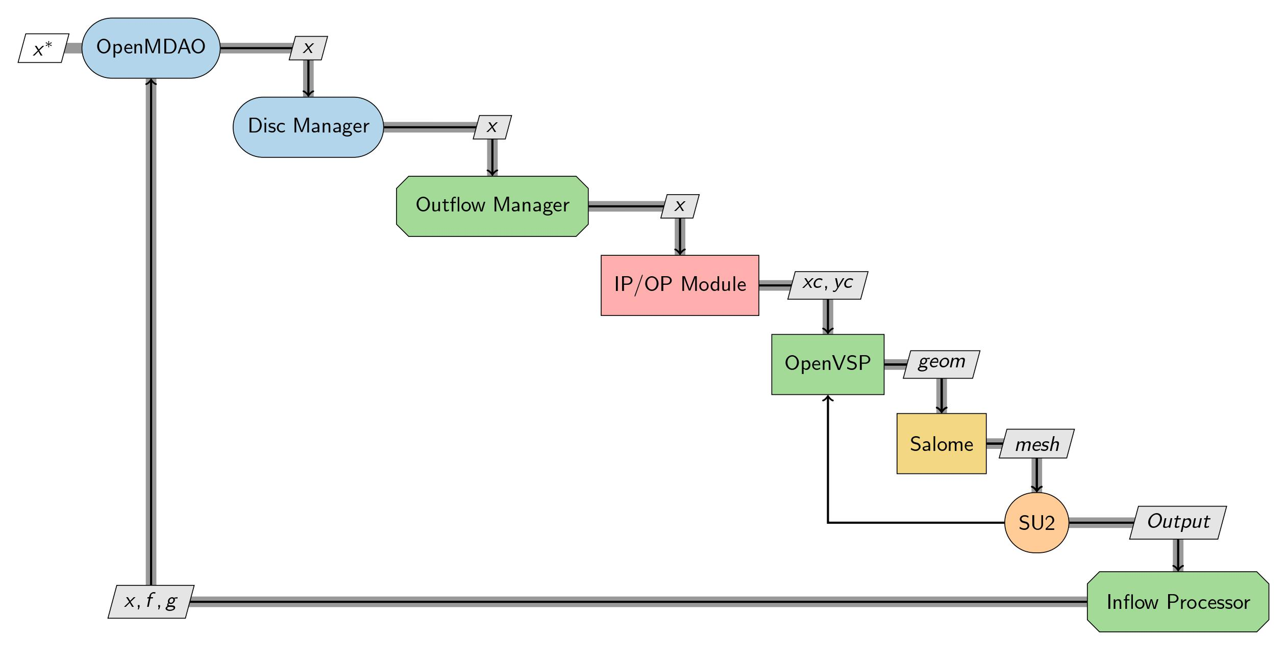
Framework for 3D ASO

Slide 24
Challenges
Adhoc constraint implementation to prevent wiggly designs
Finite Differencing is very time consuming
1 CFD ~ 5 mins
20 DV ~ 100 mins for 1 gradient calculation
100 function evaluations ~ 10,000 mins!
Adjoint based derivative ~ <5 mins for 1 gradient evaluation
Meshing strategy – Remesh entire volume
1 million ~ 2-3 mins
100 function evaluation ~ 200-300 mins
Mesh deformation ~ 4-5 seconds
Previous framework was not SCALABLE to 3D ASO problems

Slide 25
Revamping the Framework for 3D ASO with MDO Lab Tools
Pygeo
ADflow
IdWarp
Optimizer

Slide 26
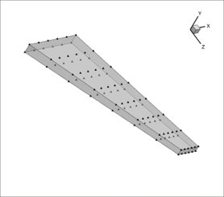
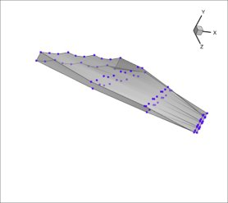
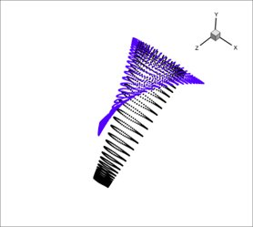
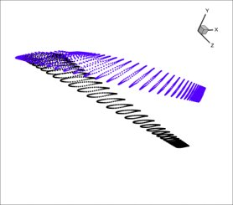
MDO Lab Tools
Notes:
Module Manager: Receives the input as vectors, the design variables are classified on the basis of their disciplines and sent to the discipline module. Module manager is the primary tool that inputs as well as outputs the necessary information from OpenMDAO to the discipline manager.

Slide 27
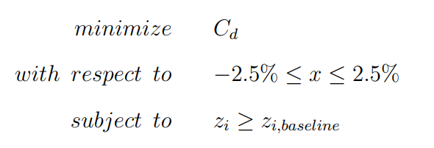
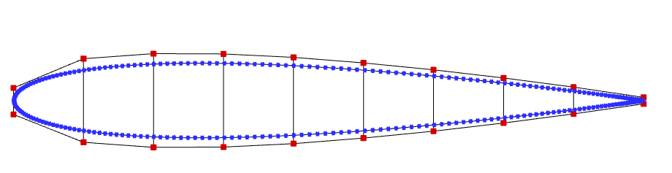
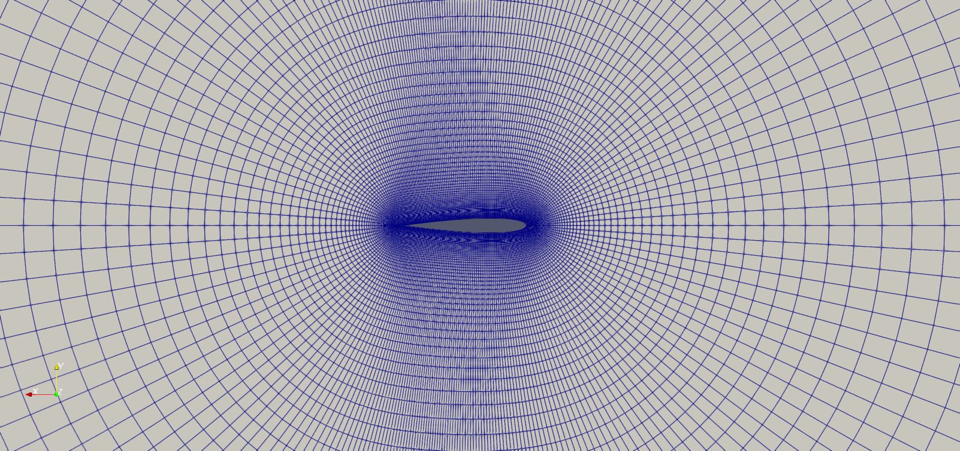
Framework Testing | Case1
Parameters | Values
Mach no. | 0.85
AoA | 0 deg
Flow | Inviscid
Solver | Euler

Slide 28
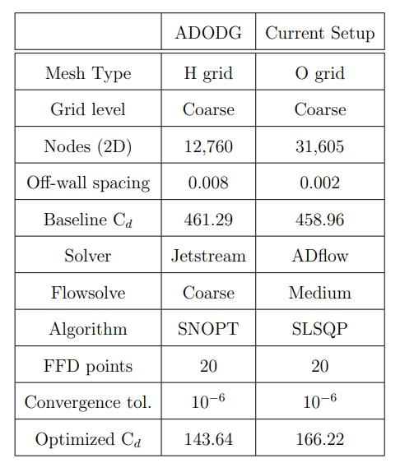
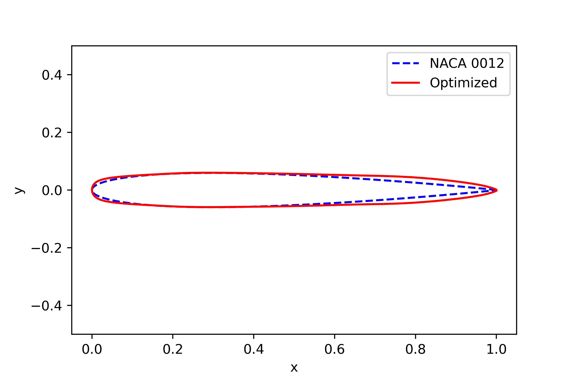
Result | Case-1

Slide 29
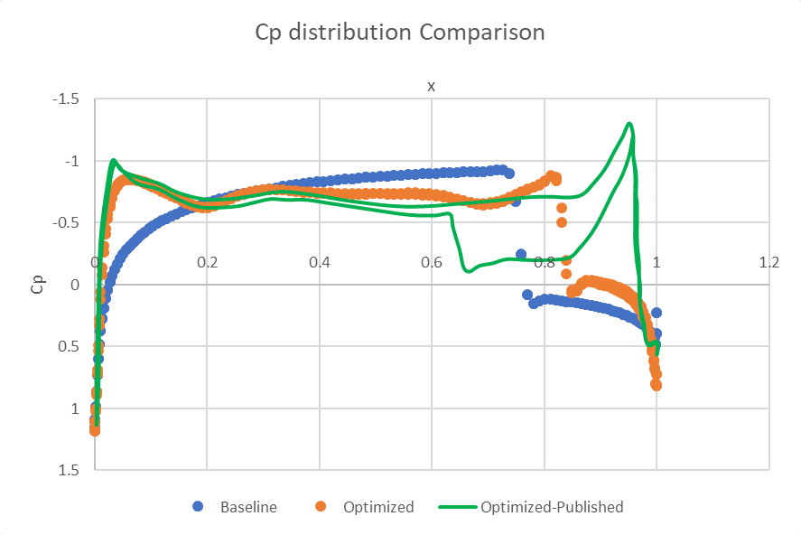
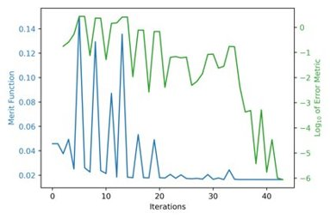
Result | Case-1

Slide 30
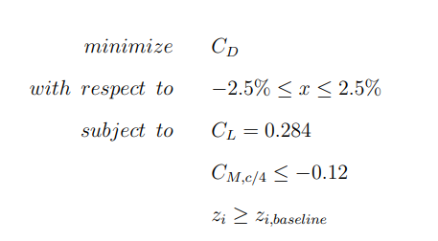
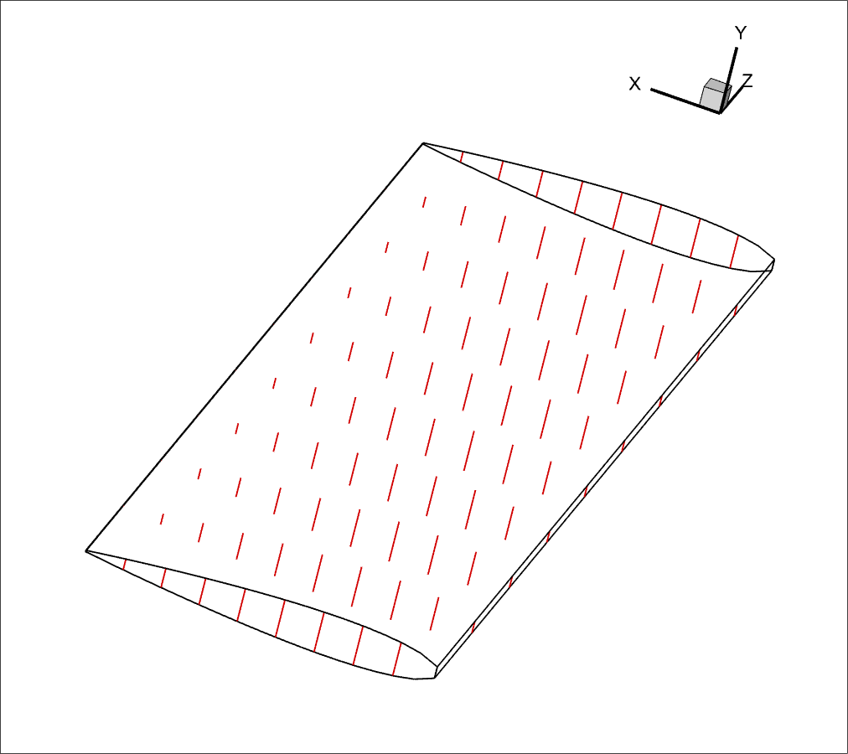
Framework Testing | Case2
Parameters | Values
Mach no. | 0.85
AoA | 2.79 deg
Flow | Turbulent – 20 Million Re
Solver | RANS
Cd reduction | 49%

Slide 31
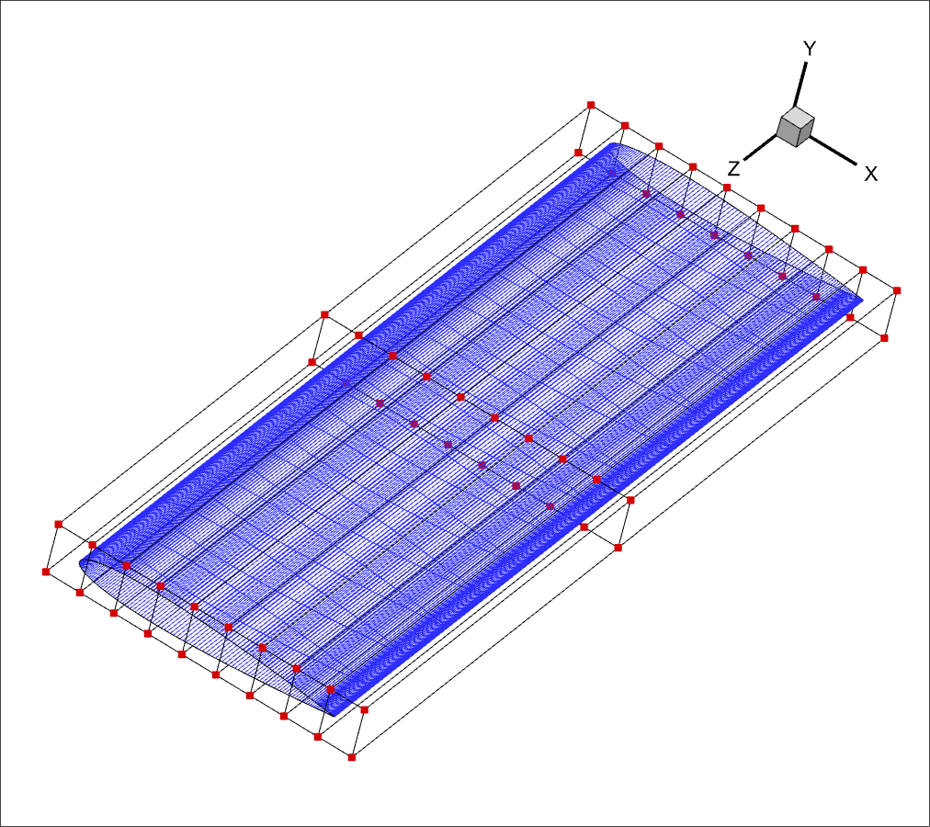
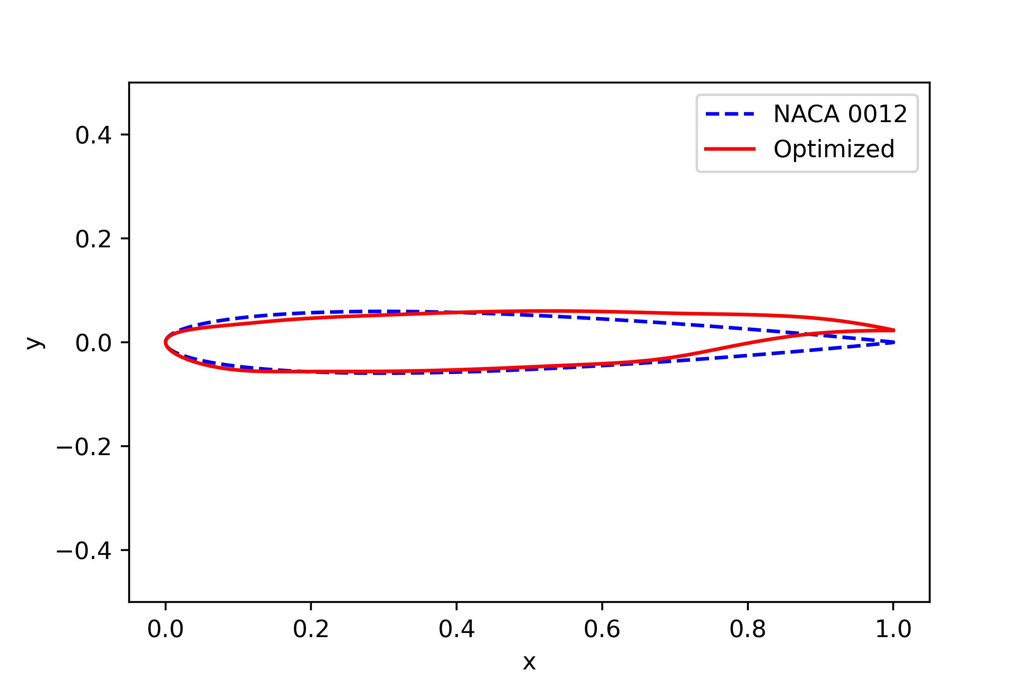
Framework Testing | Case2

Slide 32
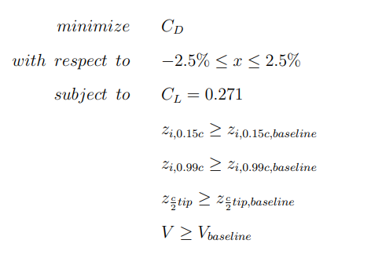
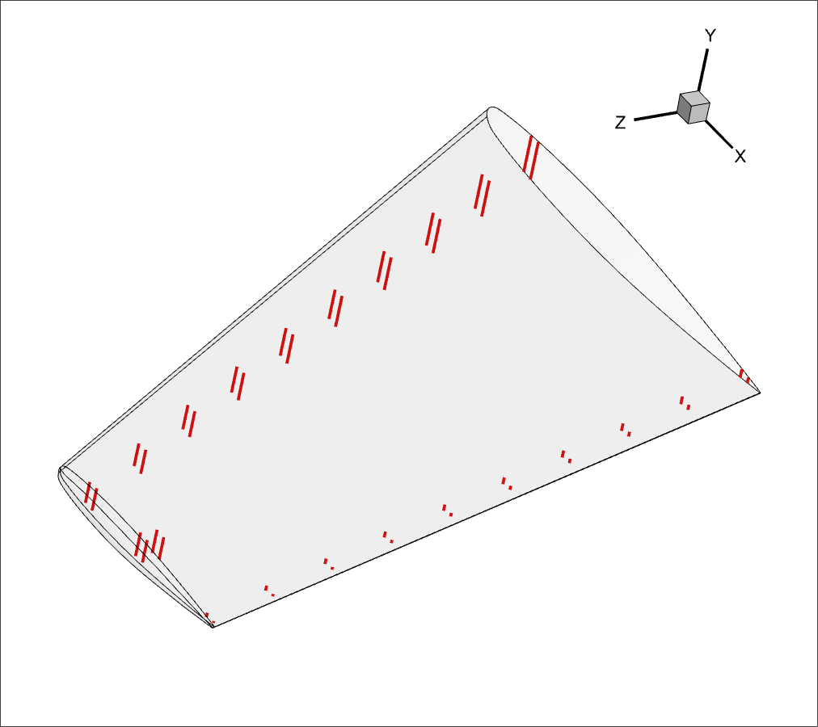
Framework Testing | Case 3
Parameters | Values
Mach no. | 0.839
AoA | 3.06 deg
Flow | Turbulent – 11 Million Re
Solver | RANS
DV | 144 shape + 6 twist

Slide 33
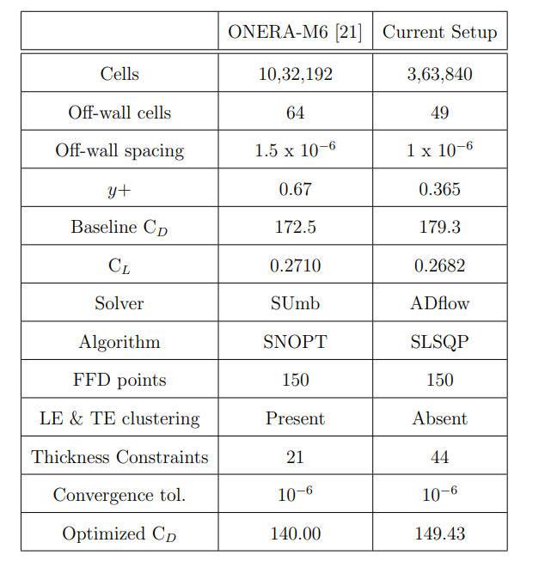
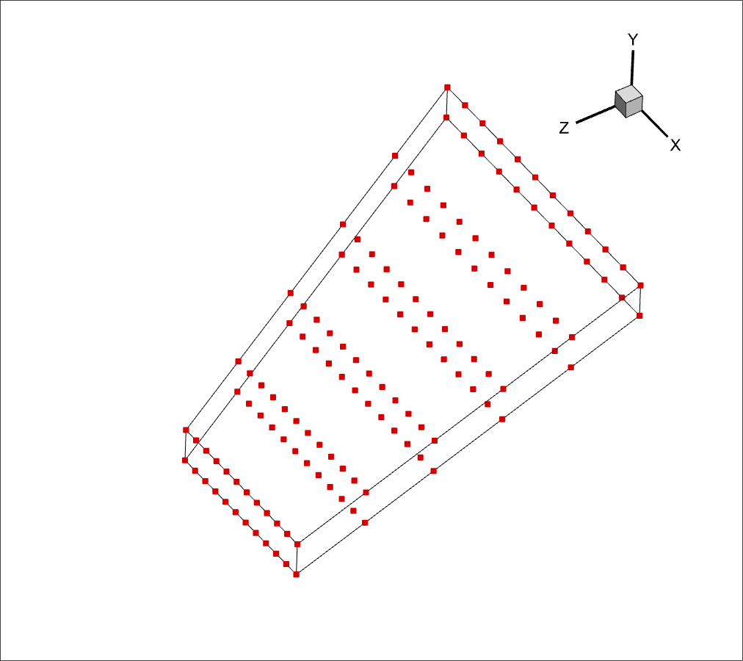
Framework Testing | Case 3

Slide 34
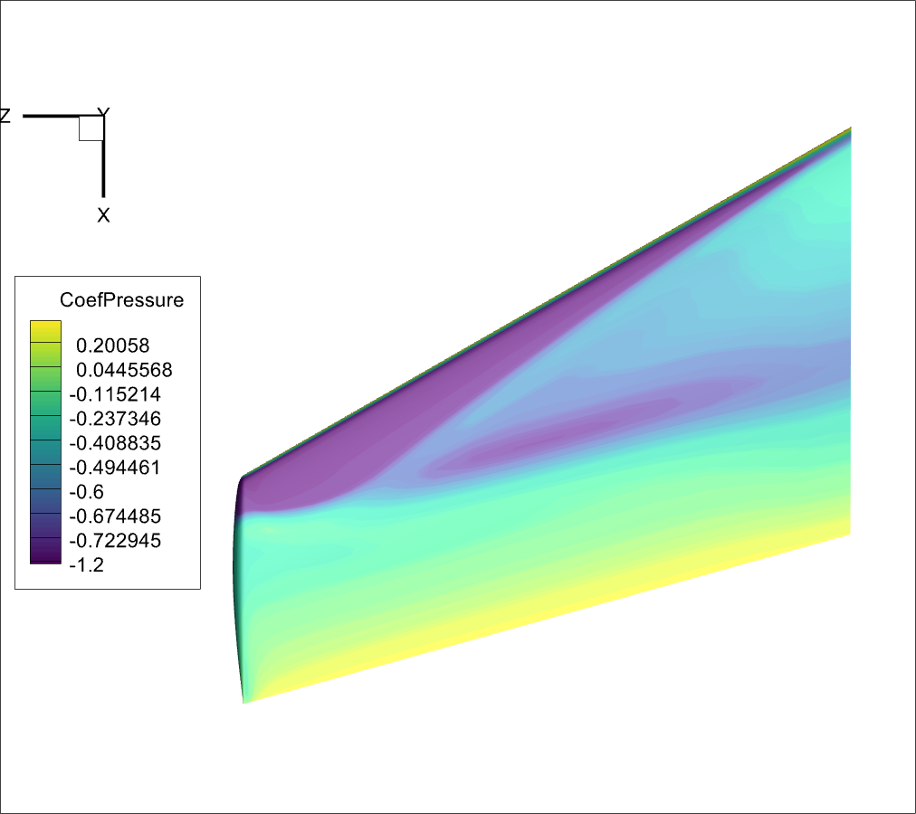
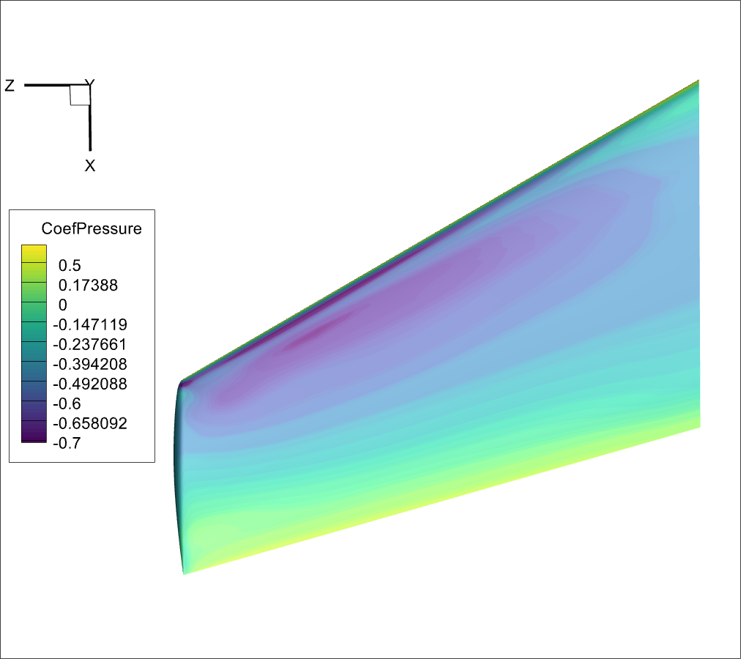
Framework Testing | Case 3

Slide 35
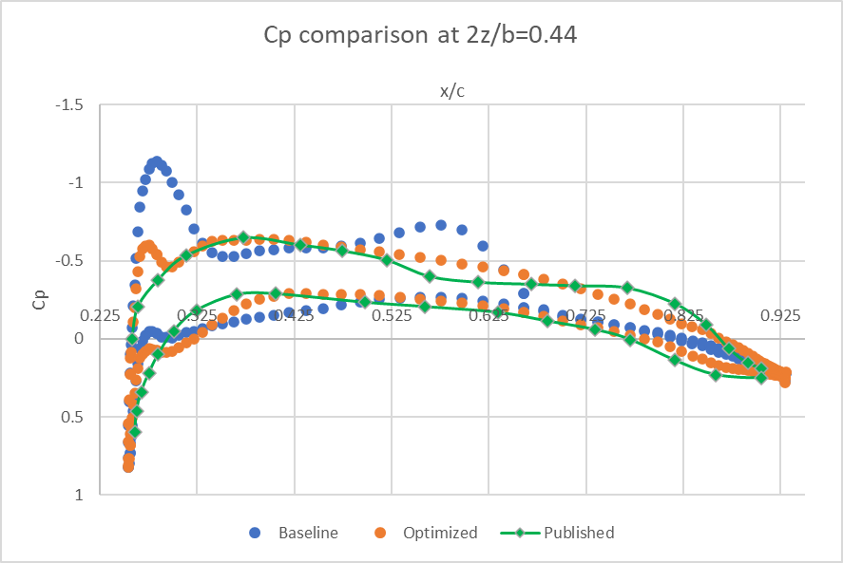
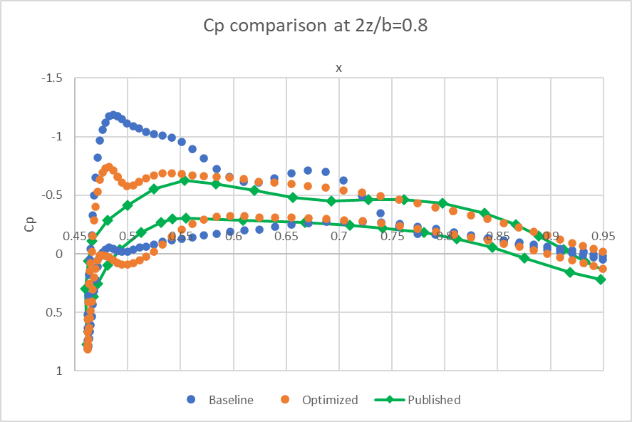
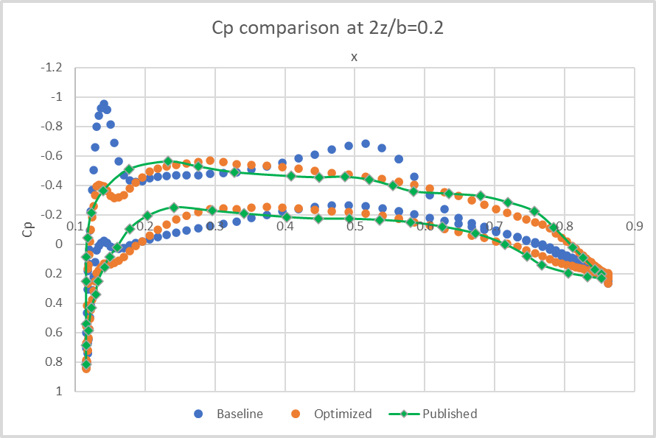
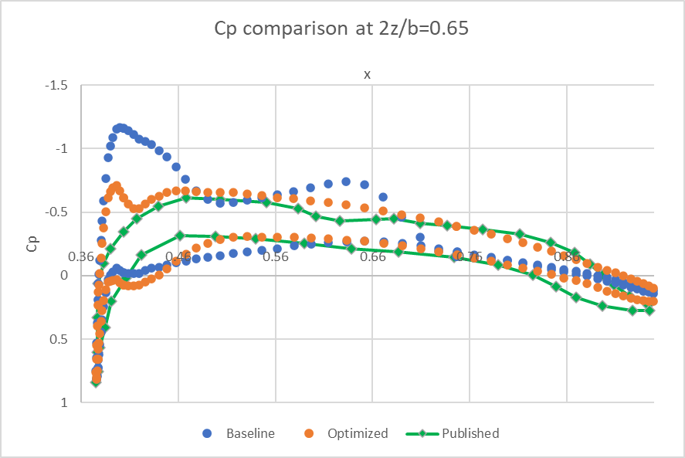

Slide 36
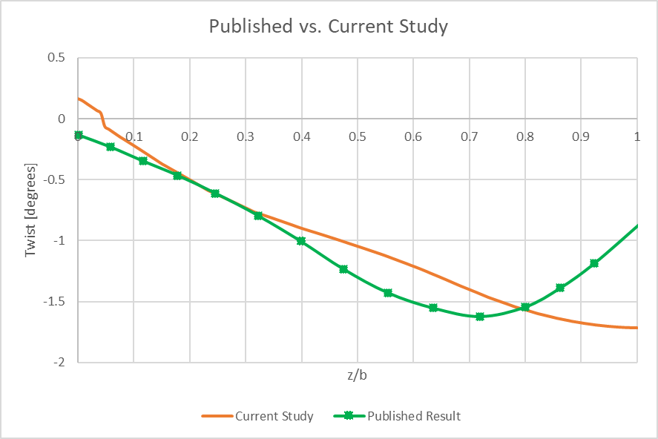
Framework Testing | Case 3

Slide 37
Conclusion and Future Work
Created a MDO framework
Specifically vetted for 2D and 3D ASO problems
It is generalizable to incorporate other disciplines
RCS module is still in process

Slide 38
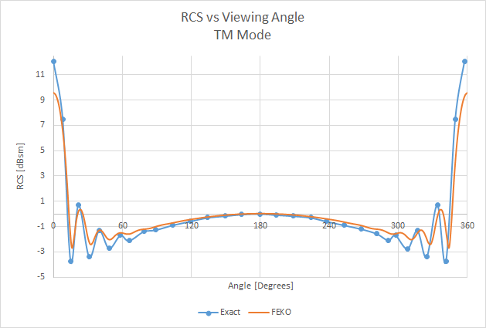
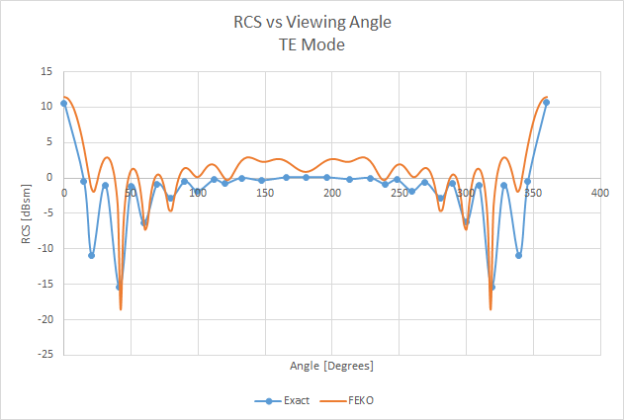
Results – 2D | FEKO Benchmarking | Cylinder
EMCC Benchmarks

Slide 39
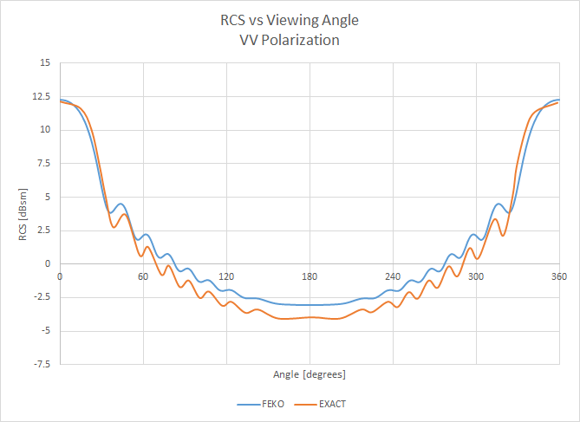
Results – 2D | FEKO Benchmarking | Airfoil

